Slide 1
Access Control Matrix
Overview
Access Control Matrix Model
  Boolean Expression Evaluation
  History
Protection State Transitions
  Commands
  Conditional Commands
Special Rights
  Principle of Attenuation of Privilege
IFETCE/M.E CSE/CS7202-NIS/Unit 1
Slide #2-<number>

Slide 2
Access Control and Authorization
Access control is a process to determine “Who does what to what,” based on a policy.
It is controlling access of who gets in and out of the system and who uses what resources, when, and in what amounts.
Access control is restricting access to a system or system resources based on something other than the identity of the user
IFETCE/M.E CSE/CS7202-NIS/Unit 1

Slide 3
Access Operations
Unix
file directory
read read from a file list directory contents
write write to a file create or rename a file in a directory
execute execute a (program) file search the directory
Access rights specific to a file are changed by my modifying the file’s entry in its directory
IFETCE/M.E CSE/CS7202-NIS/Unit 1
Slide #2-<number>

Slide 4
Access Operations
Windows NT
Permissions of Windows New Technology File System (NTFS)
  read
  write
  execute
  delete
  change permission
  change ownership
IFETCE/M.E CSE/CS7202-NIS/Unit 1
Slide #2-<number>

Slide 5
Overview
Protection state of system
  Describes current settings, values of system relevant to protection
Access control matrix
  Describes protection state precisely
  Matrix describing rights of subjects
  State transitions change elements of matrix
IFETCE/M.E CSE/CS7202-NIS/Unit 1
Slide #2-<number>

Slide 6

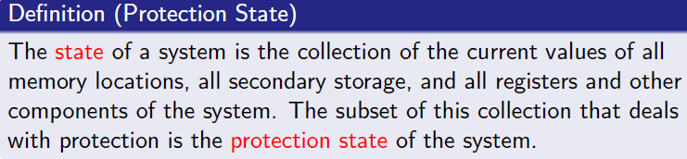
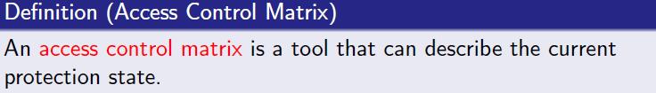
Protection State
IFETCE/M.E CSE/CS7202-NIS/Unit 1
Slide #2-<number>

Slide 7

Protection State
Consider the set of possible protection states P
Some subset consists of exactly those states in which the system is authorized to reside
Whenever the system state is in Q, the system is secure
When the current state is in , the system is not secure
Slide #2-<number>

Slide 8
Protection State (Cont’d)
Characterizing the states in Q is the function of a security policy
Preventing the system from entering a state in is the function of a security mechanism
IFETCE/M.E CSE/CS7202-NIS/Unit 1
Slide #2-<number>

Slide 9
Access Control Matrix
Access control matrix
  Describes protection state precisely
  Matrix describing rights of subjects
  State transitions change elements of matrix
An example
bill.doc edit.exe fun.com
Alice --- {execute} {execute, read}
Bob {read,write} {execute} {execute,read,write}
Slide #2-<number>
Notes:
The access control matrix model is the most precise model used to describe a protection state
It characterizes the rights of each subject with respect to every other entity
As the system changes, the protection state changes
When a command changes the state of the system, a state transition occurs
In practice, any operation on a real system causes multiple state transitions

Slide 10
Description
Subjects S = { s₁,…,s_{n} }
Objects O = { o₁,…,o_{m} }
Rights R = { r₁,…,r_{k} }
Entries A[s_{i}, o_{j}] ⊆ R
A[s_{i}, o_{j}] = { r_{x}, …, r_{y} } means subject s_{i} has rights r_{x}, …, r_{y} over object o_{j}
objects (entities)
o₁ … o_{m} s₁ … s_{n}
s₁
s₂
…
s_{n}
subjects
IFETCE/M.E CSE/CS7202-NIS/Unit 1
Slide #2-<number>

Slide 11
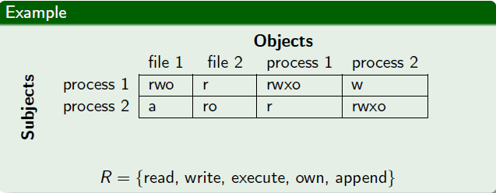
Example 1
Processes p, q
Files f, g
Rights r, w, x, a, o
IFETCE/M.E CSE/CS7202-NIS/Unit 1
Slide #2-<number>

Slide 12
Example 2
Procedures inc_ctr, dec_ctr, manage
Variable counter
Rights +, –, call
counter inc_ctr dec_ctr manage
inc_ctr +
dec_ctr –
manage call call call
IFETCE/M.E CSE/CS7202-NIS/Unit 1
Slide #2-<number>

Slide 13
Boolean Expression Evaluation
ACM controls access to database fields
  Subjects have attributes
  Verbs define type of access
  Rules associated with objects, verb pair
Subject attempts to access object
  Rule for object, verb evaluated, grants or denies access
IFETCE/M.E CSE/CS7202-NIS/Unit 1
Slide #2-<number>

Slide 14
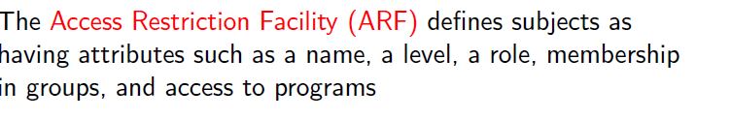
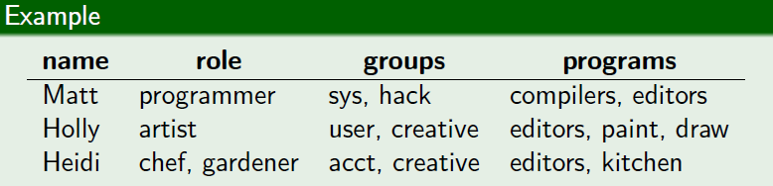
Access Control by Boolean Expression Evaluation
IFETCE/M.E CSE/CS7202-NIS/Unit 1
Slide #2-<number>

Slide 15
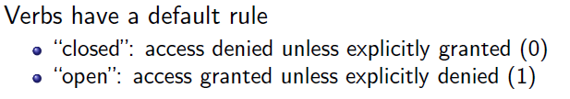

Access Control by Boolean Expression Evaluation
IFETCE/M.E CSE/CS7202-NIS/Unit 1
Slide #2-<number>

Slide 16

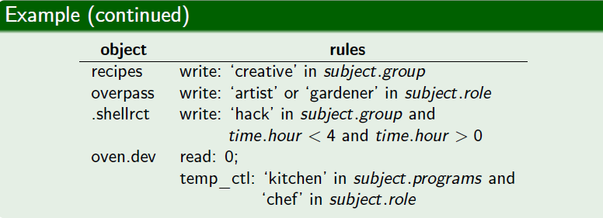
Access Control by Boolean Expression Evaluation
IFETCE/M.E CSE/CS7202-NIS/Unit 1
Slide #2-<number>

Slide 17
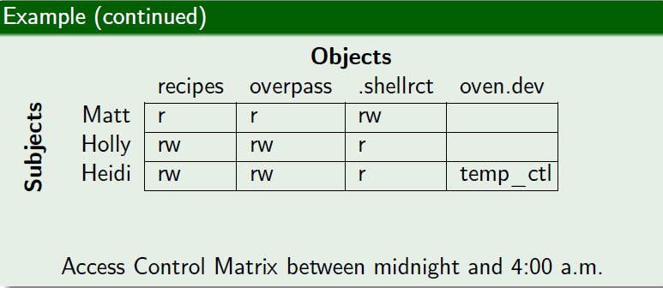
Access Control by Boolean Expression Evaluation
IFETCE/M.E CSE/CS7202-NIS/Unit 1
Slide #2-<number>

Slide 18
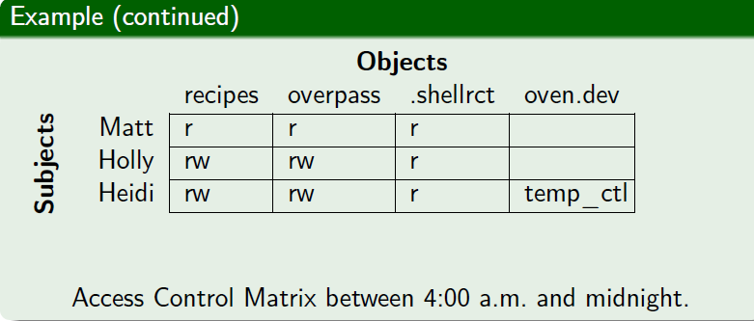
Access Control by Boolean Expression Evaluation
IFETCE/M.E CSE/CS7202-NIS/Unit 1
Slide #2-<number>

Slide 19
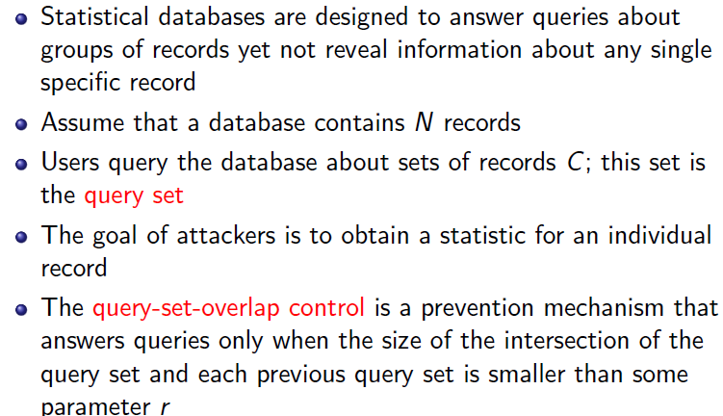
Access Controlled by History
IFETCE/M.E CSE/CS7202-NIS/Unit 1
Slide #2-<number>

Slide 20
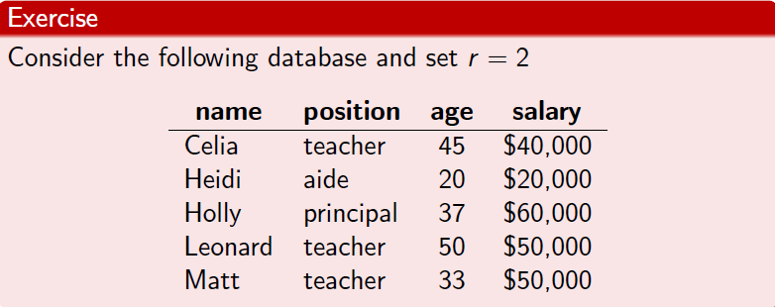
Access Controlled by History
IFETCE/M.E CSE/CS7202-NIS/Unit 1
Slide #2-<number>

Slide 21
ACM of Database Queries
O_{i} = { objects referenced in query i }
f(o_{i}) = { read } for o_{j} ∈ O_{i}, if |∪_{j = 1,…,i} O_{j}| < 2
f(o_{i}) = ∅ for o_{j} ∈ O_{i}, otherwise
O₁ = { Celia, Leonard, Matt} and no previous query set, so:
A[asker, Celia, Leonard, Matt] = { read }
and query can be answered
IFETCE/M.E CSE/CS7202-NIS/Unit 1
Slide #2-<number>

Slide 22
Query 2
From last slide:
f(o_{i}) = { read } for o_{j} in O_{i}, if |∪_{j = 1,…,i} O_{j}| > 1
f(o_{i}) = ∅ for o_{j} in O_{i}, otherwise
O₂ = { Matt} but | O₂ ∪ O₁ | = 2 so
A[asker, (Holly,Leonard)] = read
and query can be answered
IFETCE/M.E CSE/CS7202-NIS/Unit 1
Slide #2-<number>

Slide 23
But Query 3
From last slide:
f(o_{i}) = { read } for o_{j} in O_{i}, if |∪_{j = 1,…,i} O_{j}| > 1
f(o_{i}) = ∅ for o_{j} in O_{i}, otherwise
3. O₃ = { Matt} but |O₃∪ O₂ ∪ O₁ | = 1 so
A[asker, (Holly, Leonard,Matt)] = ∅
and query cannot be answered
IFETCE/M.E CSE/CS7202-NIS/Unit 1
Slide #2-<number>

Slide 24
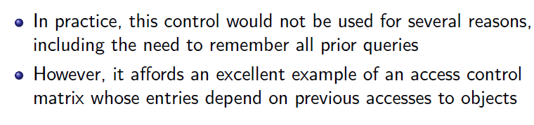
Access Controlled by History
IFETCE/M.E CSE/CS7202-NIS/Unit 1
Slide #2-<number>

Slide 25
Access Control Matrix
Capabilities
If the access rights are kept with the subjects then
these are the subject’s access rights.
Every subject is given a capability.
Alice’s capability: edit.exe: execute; fun.com: execute, read
Bob’s capability: bill.doc: read, write; edit.exe: execute;
fun.com: execute, read, write
IFETCE/M.E CSE/CS7202-NIS/Unit 1
Slide #2-<number>

Slide 26
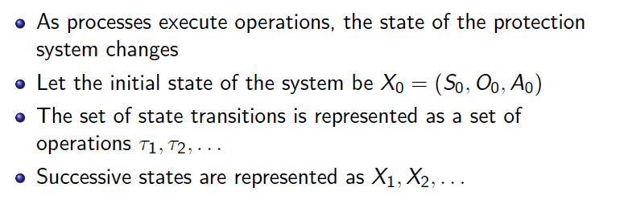
Protection State Transitions
IFETCE/M.E CSE/CS7202-NIS/Unit 1
Slide #2-<number>

Slide 27
State Transitions
Change the protection state of system
|– represents transition
  X_{i} |– _{τ} X_{i+1}: command τ moves system from state X_{i} to X_{i+1}
  X_{i} |– * X_{i+1}: a sequence of commands moves system from state X_{i} to X_{i+1}
Commands often called transformation procedures
IFETCE/M.E CSE/CS7202-NIS/Unit 1
Slide #2-<number>

Slide 28
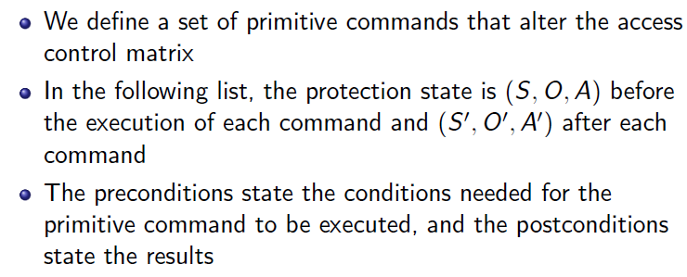
Primitive Commands
IFETCE/M.E CSE/CS7202-NIS/Unit 1
Slide #2-<number>

Slide 29
Primitive Operations
create subject s; create object o
  Creates new row, column in ACM; creates new column in ACM
destroy subject s; destroy object o
  Deletes row, column from ACM; deletes column from ACM
enter r into A[s, o]
  Adds r rights for subject s over object o
delete r from A[s, o]
  Removes r rights from subject s over object o
IFETCE/M.E CSE/CS7202-NIS/Unit 1
Slide #2-<number>

Slide 30
Create Subject
Precondition: s ∉ S
Primitive command: create subject s
Postconditions:
  S′ = S ∪{ s }, O′ = O ∪{ s }
  (∀y ∈ O′)[a′[s, y] = ∅], (∀x ∈ S′)[a′[x, s] = ∅]
  (∀x ∈ S)(∀y ∈ O)[a′[x, y] = a[x, y]]
IFETCE/M.E CSE/CS7202-NIS/Unit 1
Slide #2-<number>

Slide 31
Create Object
Precondition: o ∉ O
Primitive command: create object o
Postconditions:
  S′ = S, O′ = O ∪ { o }
  (∀x ∈ S′)[a′[x, o] = ∅]
  (∀x ∈ S)(∀y ∈ O)[a′[x, y] = a[x, y]]
IFETCE/M.E CSE/CS7202-NIS/Unit 1
Slide #2-<number>

Slide 32
Add Right
Precondition: s ∈ S, o ∈ O
Primitive command: enter r into a[s, o]
Postconditions:
  S′ = S, O′ = O
  a′[s, o] = a[s, o] ∪ { r }
  (∀x ∈ S′)(∀y ∈ O′ – { o }) [a′[x, y] = a[x, y]]
  (∀x ∈ S′ – { s })(∀y ∈ O′) [a′[x, y] = a[x, y]]
IFETCE/M.E CSE/CS7202-NIS/Unit 1
Slide #2-<number>

Slide 33
Delete Right
Precondition: s ∈ S, o ∈ O
Primitive command: delete r from a[s, o]
Postconditions:
  S′ = S, O′ = O
  a′[s, o] = a[s, o] – { r }
  (∀x ∈ S′)(∀y ∈ O′ – { o }) [a′[x, y] = a[x, y]]
  (∀x ∈ S′ – { s })(∀y ∈ O′) [a′[x, y] = a[x, y]]
IFETCE/M.E CSE/CS7202-NIS/Unit 1
Slide #2-<number>

Slide 34
Destroy Subject
Precondition: s ∈ S
Primitive command: destroy subject s
Postconditions:
  S′ = S – { s }, O′ = O – { s }
  (∀y ∈ O′)[a′[s, y] = ∅], (∀x ∈ S′)[a´[x, s] = ∅]
  (∀x ∈ S′)(∀y ∈ O′) [a′[x, y] = a[x, y]]
IFETCE/M.E CSE/CS7202-NIS/Unit 1
Slide #2-<number>

Slide 35
Destroy Object
Precondition: o ∈ O
Primitive command: destroy object o
Postconditions:
  S′ = S, O′ = O – { o }
  (∀x ∈ S′)[a′[x, o] = ∅]
  (∀x ∈ S′)(∀y ∈ O′) [a′[x, y] = a[x, y]]
IFETCE/M.E CSE/CS7202-NIS/Unit 1
Slide #2-<number>

Slide 36
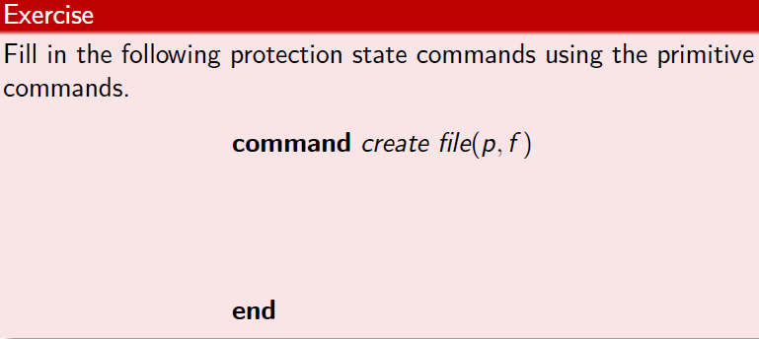
Protection State Commands
IFETCE/M.E CSE/CS7202-NIS/Unit 1
Slide #2-<number>

Slide 37
Creating File
Process p creates file f with r and w permission
command create•file(p, f)
create object f;
enter own into A[p, f];
enter r into A[p, f];
enter w into A[p, f];
end
IFETCE/M.E CSE/CS7202-NIS/Unit 1
Slide #2-<number>

Slide 38
Mono-Operational Commands
Make process p the owner of file g
command make•owner(p, g)
enter own into A[p, g];
end
Mono-operational command
  Single primitive operation in this command
IFETCE/M.E CSE/CS7202-NIS/Unit 1
Slide #2-<number>

Slide 39
Conditional Commands
Let p give q r rights over f, if p owns f
command grant•read•file•1(p, f, q)
if own in A[p, f]
then
enter r into A[q, f];
end
Mono-conditional command
  Single condition in this command
IFETCE/M.E CSE/CS7202-NIS/Unit 1
Slide #2-<number>

Slide 40
Multiple Conditions
Let p give q r and w rights over f, if p owns f and p has c rights over q
command grant•read•file•2(p, f, q)
if own in A[p, f] and c in A[p, q]
then
enter r into A[q, f];
enter w into A[q, f];
end
IFETCE/M.E CSE/CS7202-NIS/Unit 1
Slide #2-<number>

Slide 41
Copy Right
Allows possessor to give rights to another
Often attached to a right, so only applies to that right
  r is read right that cannot be copied
  rc is read right that can be copied
Is copy flag copied when giving r rights?
  Depends on model, instantiation of model
IFETCE/M.E CSE/CS7202-NIS/Unit 1
Slide #2-<number>

Slide 42
Own Right
Usually allows possessor to change entries in ACM column
  So owner of object can add, delete rights for others
  May depend on what system allows
    Can’t give rights to specific (set of) users
    Can’t pass copy flag to specific (set of) users
IFETCE/M.E CSE/CS7202-NIS/Unit 1
Slide #2-<number>

Slide 43

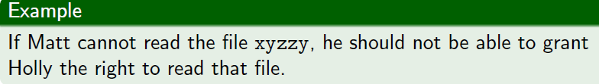
Principle of Attenuation Privilege
IFETCE/M.E CSE/CS7202-NIS/Unit 1
Slide #2-<number>

Slide 44
Attenuation of Privilege
Principle says you can’t give rights you do not possess
  Restricts addition of rights within a system
  Usually ignored for owner
    Why? Owner gives herself rights, gives them to others, deletes her rights.
IFETCE/M.E CSE/CS7202-NIS/Unit 1
Slide #2-<number>

Slide 45
Key Points
Access control matrix simplest abstraction mechanism for representing protection state
Transitions alter protection state
6 primitive operations alter matrix
  Transitions can be expressed as commands composed of these operations and, possibly, conditions
IFETCE/M.E CSE/CS7202-NIS/Unit 1
Slide #2-<number>

Slide 46
Access Control Matrix
Access rights can be kept with the
subjects or the
objects.
IFETCE/M.E CSE/CS7202-NIS/Unit 1
Slide #2-<number>

Slide 47
Access Control Matrix
Access control lists (ACL)
An ACL stores the access rights to an object with
the object itself.
ACL for bill.doc: Bob: read write
ACL for edit.exe: Alice: execute; Bill: execute
ACL for fun.com: Alice: execute, read; Bill: execute, read, write
IFETCE/M.E CSE/CS7202-NIS/Unit 1
Slide #2-<number>

Slide 48
Access Control Matrix
Access control lists (ACL)
Management of access rights can be cumbersome.
Therefore users are placed in groups, and derive
access from a user’s group.
IFETCE/M.E CSE/CS7202-NIS/Unit 1
Slide #2-<number>

